Slide 1
The ECML

Slide 2
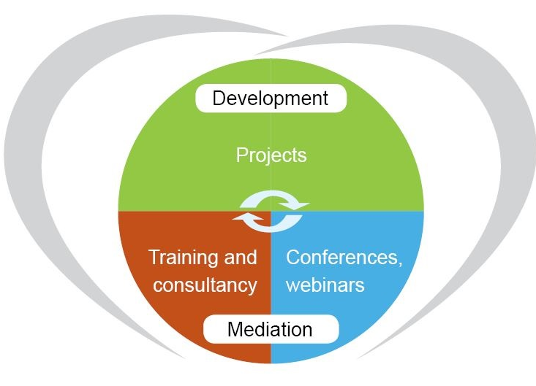
Inspiring innovation in language education:
changing contexts, evolving competences
Our vision
A Europe committed to linguistic and cultural diversity, where the key role of quality language education in achieving intercultural dialogue, democratic citizenship and social cohesion is recognised and supported.

Slide 3
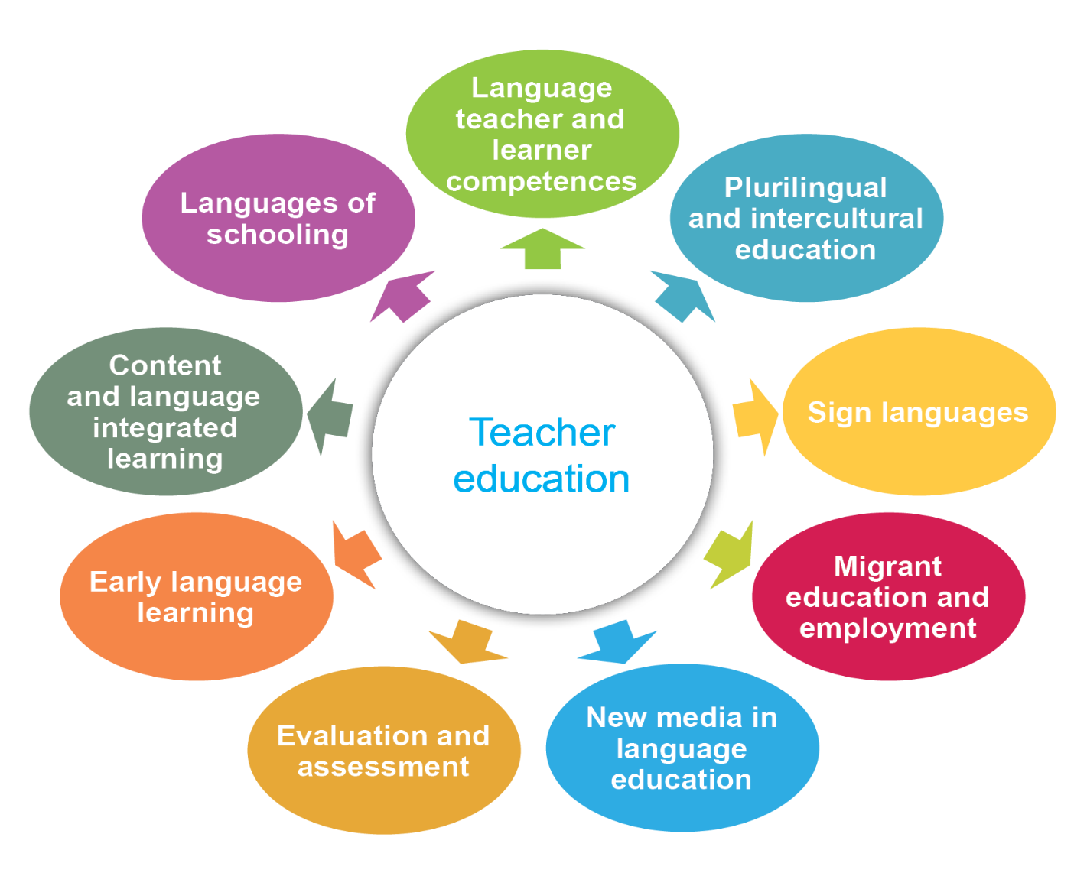
ECML Thematic Areas

Slide 4
What makes the ECML unique?
At the interface of research, policy and practice; working at multiple levels
Tapping into cutting-edge knowledge and expertise from across its 33 member states and beyond
Underpinned by processes of democratic dialogue and negotiation
What makes our projects unique?
Research-informed but focused on practice with clearly-defined target groups
Relevance and adaptability of outputs to different contexts strengthened and enriched through discussion with experts and wider stakeholders
Bilingual
The only pan-European platform of its kind: a truly intercultural learning organisation

